Slide 1
Unit Design guideline (TUD)

Slide 2
OUTLINE
Create UD document from TCD
UML
Update method
Note

Slide 3
Create UD document from TCD
Step 1: Get UD generation tool from this link
\\rvc-vnas-01\DTV\Documents\Knowledge_Management\05_Database_RVASW\01_McalDevelopment\05_UnitDesign\02_TUD\08.LinkGDD\
Step 2: install docxpy library on Cygwin (pip install docxpy)

Slide 4
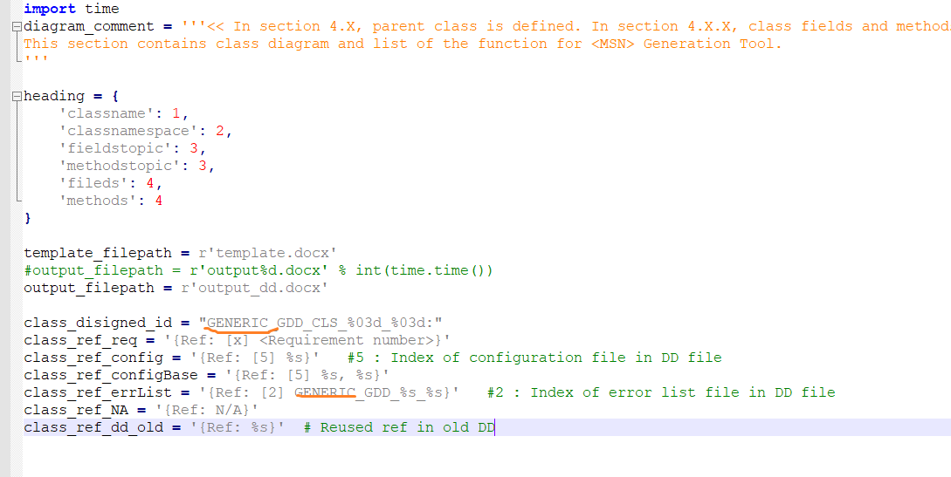
Create UD document from TCD
In file template_str.py, please rename to your module name for variables such as class_disigned_id, class_ref_errList.
Note: refer to “Guideline creating DD from CD.doc” for more details

Slide 5
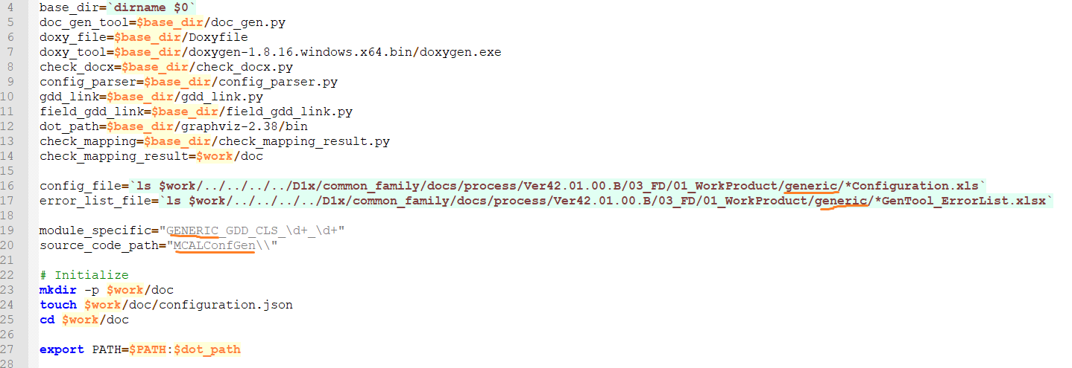
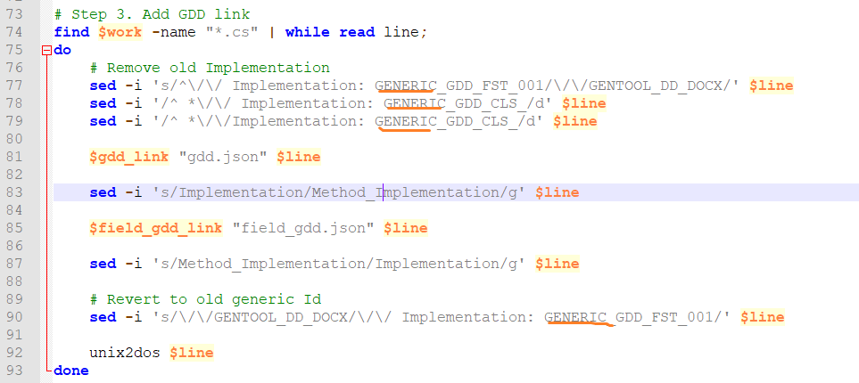
Create UD document from TCD
In file auto_doc.sh, please rename to your module name for variables such as config_file and error_list_file, module_specific, source_code_path, and line 77,78,79, 90
Note: refer to “Guideline creating DD from CD.doc” for more details

Slide 6
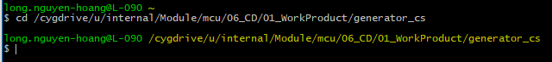
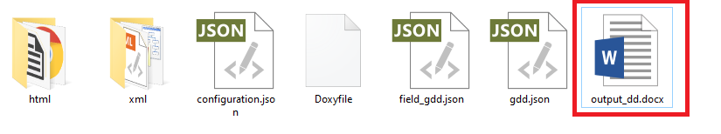
Create UD document from TCD
- Let type command “cd” to your TCODE using Cygwin
- Drag file auto_doc.sh and drop in Cygwin and Run
- After run completed, “doc” folder contain detail design
Note: refer to “Guideline creating DD from CD.doc” for more details

Slide 7
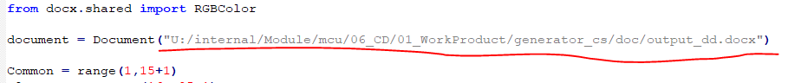
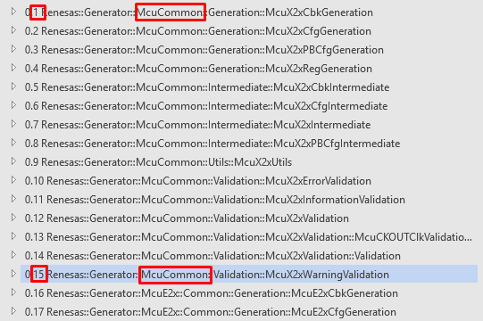
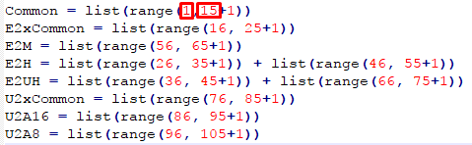
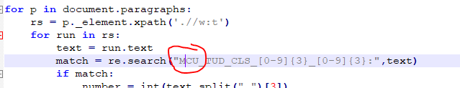
Create UD document from TCD
- Get fill Attribute tool at
https://svn.banvien.com.vn/svn/RVC/trunk/BV_Training/RVC_MCAL_Guideline/TUT/Tools/03_FillAttributeDocument
- Update location of document
- Update number in range
E2xFCC
Similar for E2xCommon, E2M, E2H, E2UH, U2xCommon,
U2A16, U2A8
- Run WordReplace.py then new.docx will be created

Slide 8
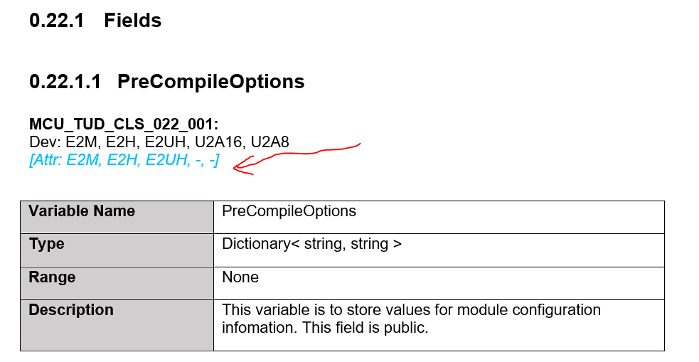
Create UD document from TCD
- Open new.docx then check Attr section at every class.

Slide 9
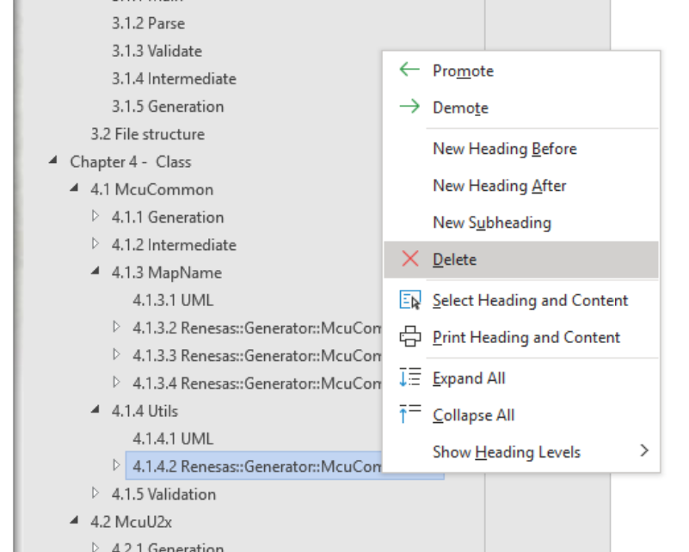
Create UD document from TCD
- Make a back-up of TUD for merging.
- Open RH850_X2x_<MSN>_GenTool_UD.docx then delete sections in Generation/Intermediate/Utils/Validation except UML section.
- Move “deleted sections” from new.docx to RH850_X2x_<MSN>_GenTool_UD.docx

Slide 10
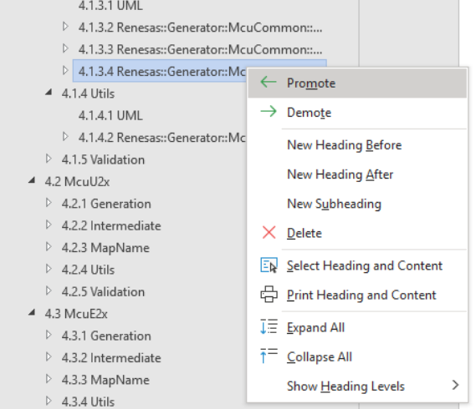
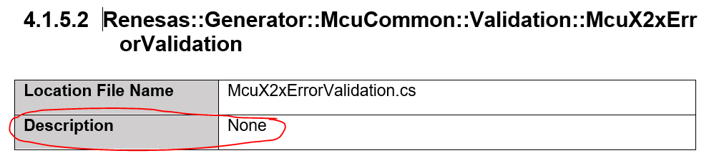
Create UD document from TCD
- Choose Promote/Demote to adjust items.
- Remember to update Description of each class (refer to back-up file of TUD).

Slide 11
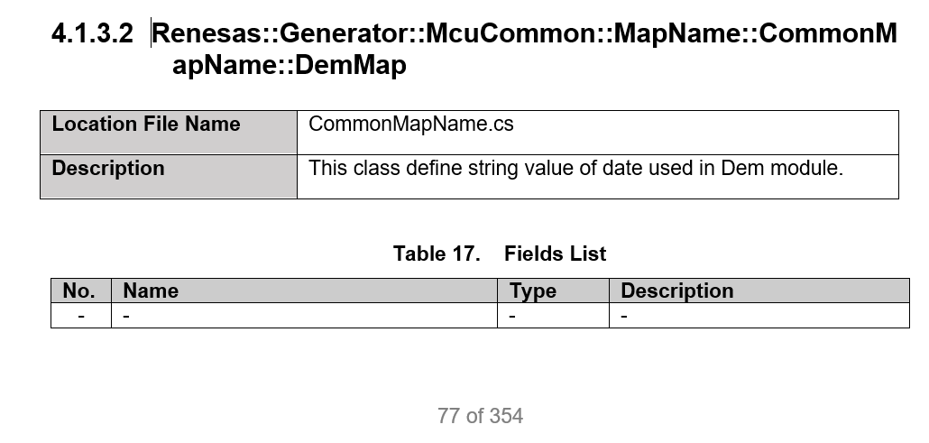
Create UD document from TCD
- About MapName class, you must manually update it.
- MapName only contains Location file Name, Description, Field List table, Method List table, Field section and Method section .

Slide 12
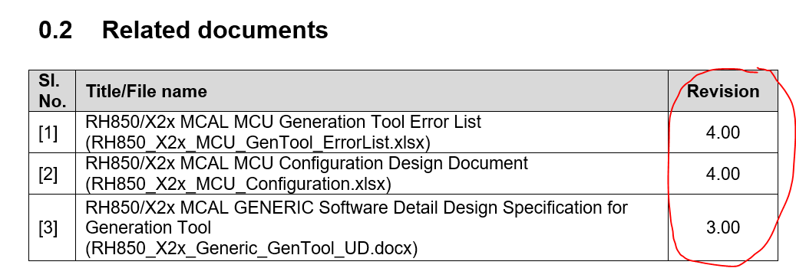
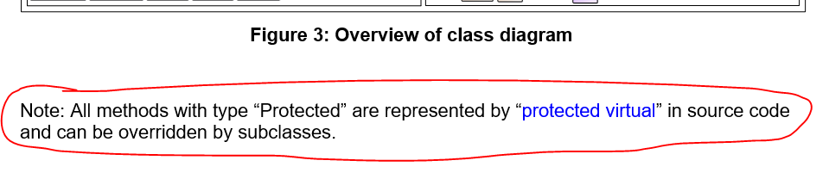
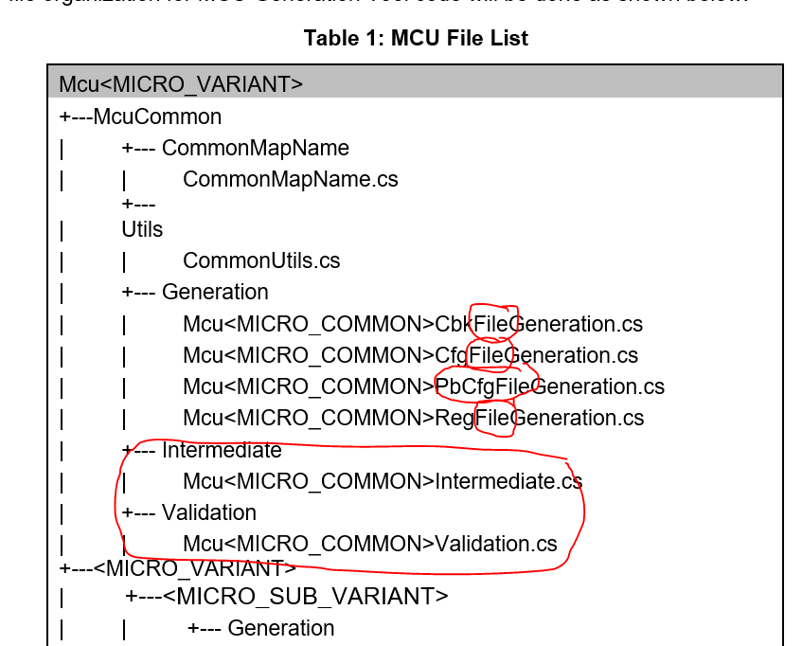
Create UD document from TCD
- Update sections that are no longer correct.

Slide 13
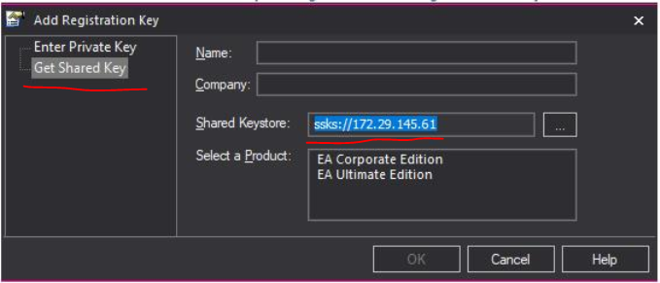
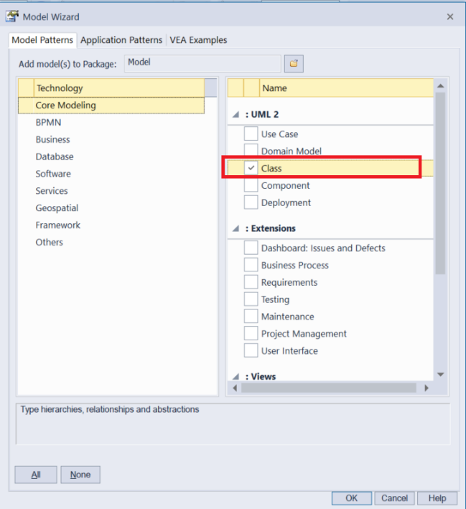
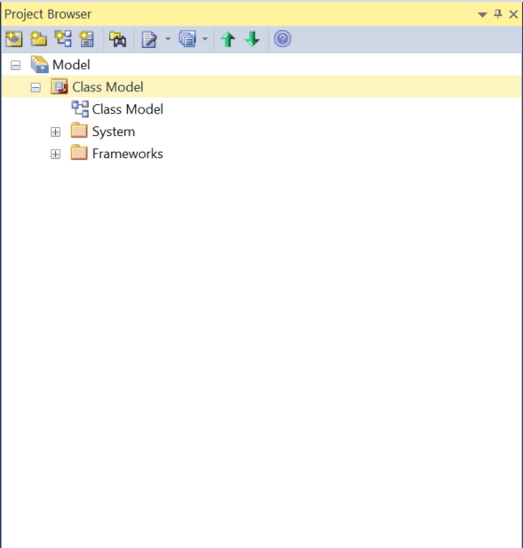
UML
Open Enterprise Architect and add registration key.
Ctrl + N to create new project
A dialog display, you choose type of diagram as Class Diagram
On the right panel, you can see project explorer with class model
Note: refer to “ClassDiagramGenerationTutorial.docx” in 01_Gen_UD\01_Guildeline\ for more details

Slide 14
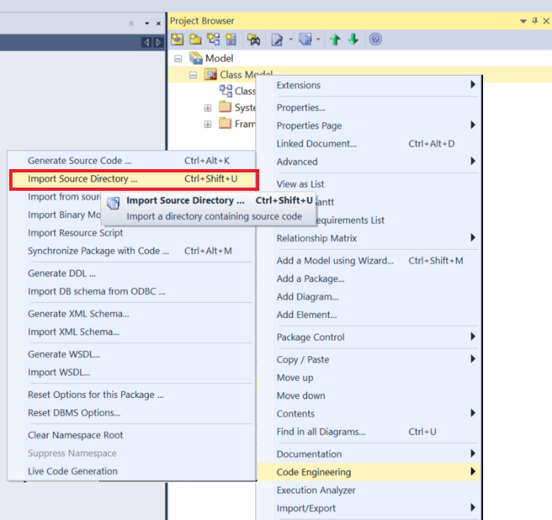
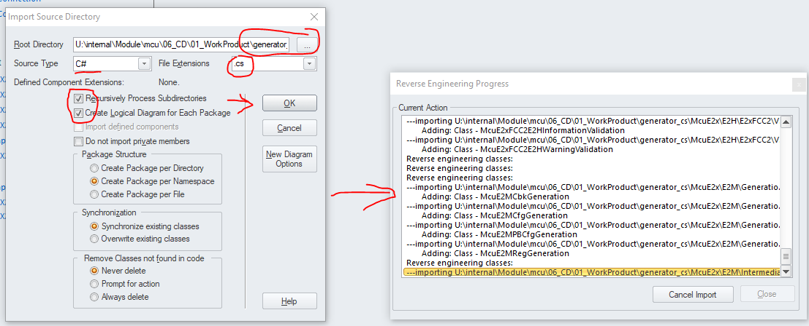
UML
Let’s choose module TCD/Generic location first by right click Class Model package -> Code Engineering -> Import Source Directory
Note: refer to “ClassDiagramGenerationTutorial.docx” in 01_Gen_UD\01_Guildeline\ for more details

Slide 15
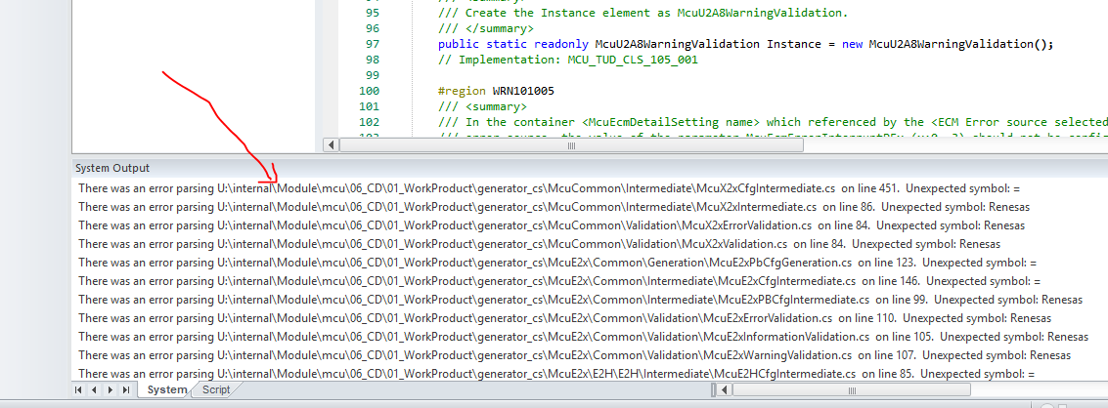
UML
Check system output after import TCD
Note: refer to “ClassDiagramGenerationTutorial.docx” in 01_Gen_UD\01_Guildeline\ for more details

Slide 16
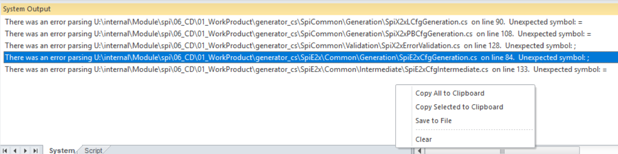
UML
Let’s add comment in source code to ignore C# syntax error in EA
- Clear system output and import input again until there is no error.
- Must import both Generic + Msn (do it one by one).
Note: refer to “ClassDiagramGenerationTutorial.docx” in 01_Gen_UD\01_Guildeline\ for more details

Slide 17
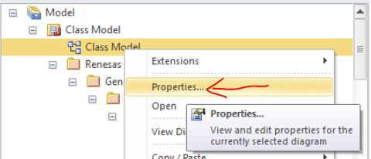
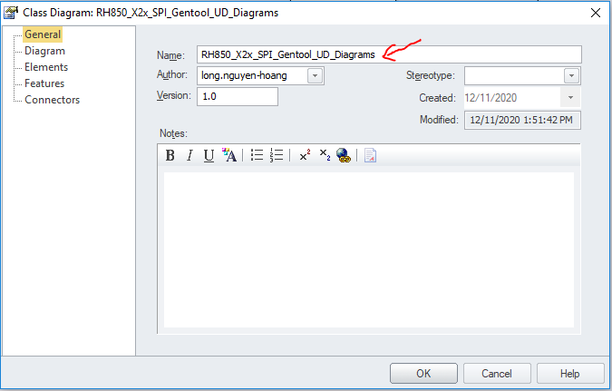
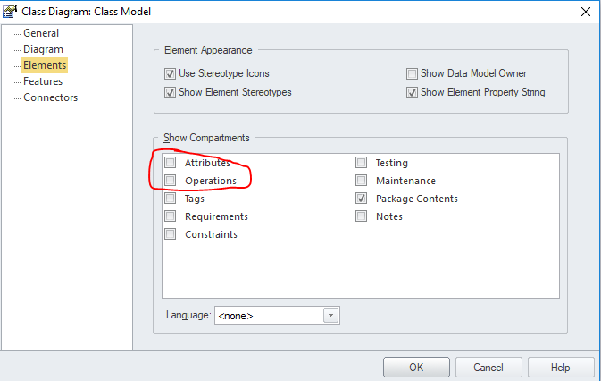
UML
Because a class in Generation Tool has many attributes and methods, so you should hide them from diagram model.
To do this, right click on Class Model -> Properties -> General change name to RH850_X2x_<MSN>_Gentool_UD_Diagrams then at Elements uncheck Attributes / Operations
Note: refer to “ClassDiagramGenerationTutorial.docx” in 01_Gen_UD\01_Guildeline\ for more details

Slide 18
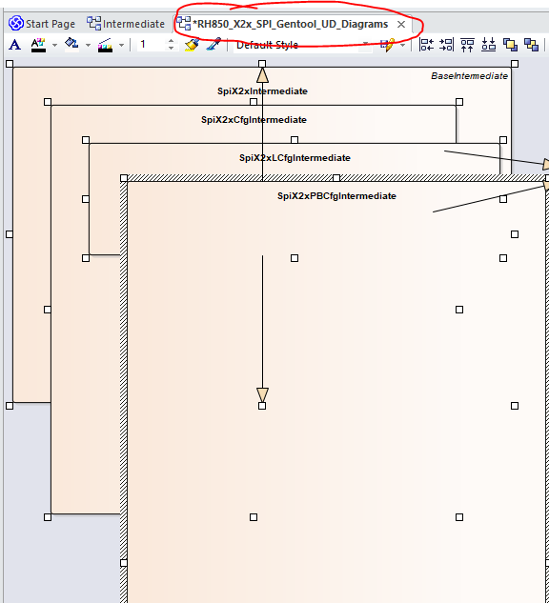
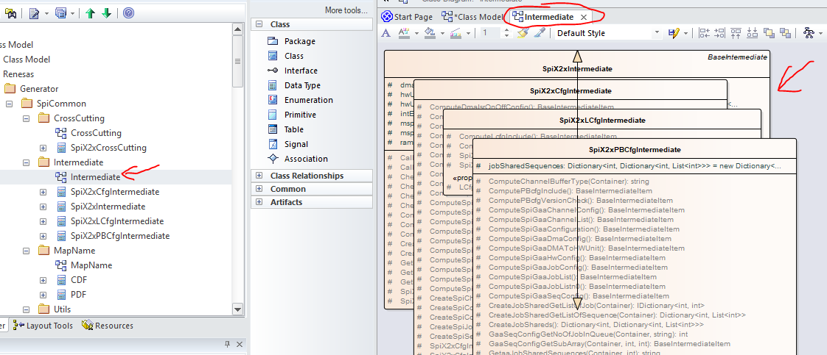
UML
Click to each class (both Msn and Generic), press Ctrl + A and Ctrl + C to copy all blocks and paste to RH850_X2x_<MSN>_Gentool_UD_Diagrams
Note: refer to “ClassDiagramGenerationTutorial.docx” in 01_Gen_UD\01_Guildeline\ for more details

Slide 19
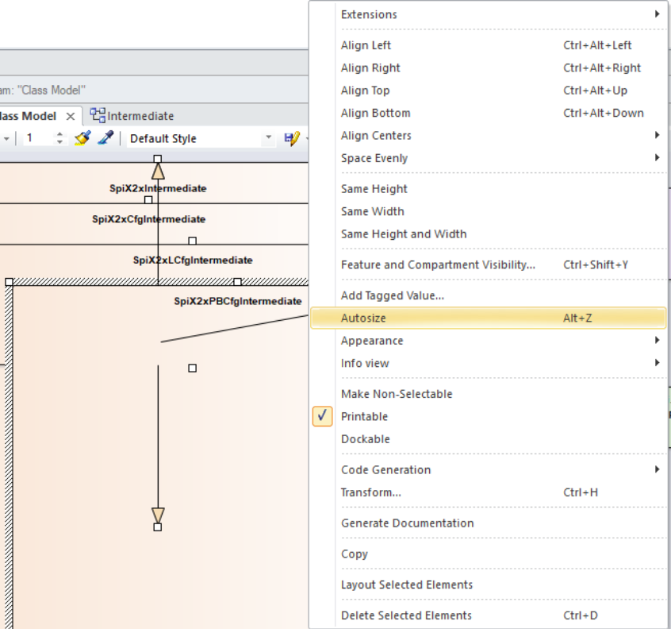
UML
Press Alt + Z to autosize selected blocks
Note: refer to “ClassDiagramGenerationTutorial.docx” in 01_Gen_UD\01_Guildeline\ for more details

Slide 20
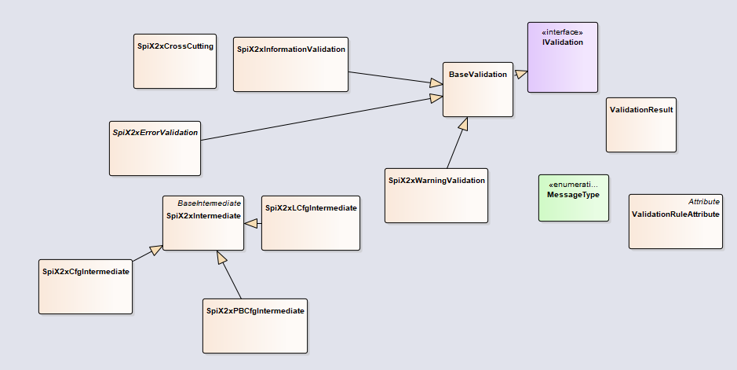
UML
Let’s route all related blocks and drag blocks together and arrange them neatly
Note: refer to “ClassDiagramGenerationTutorial.docx” in 01_Gen_UD\01_Guildeline\ for more details

Slide 21
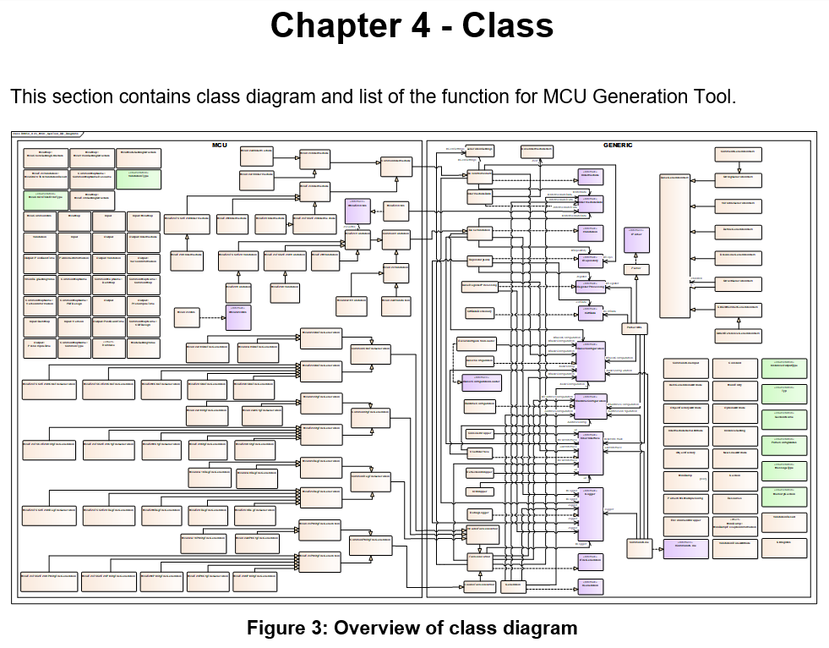
UML
Press Ctrl + A and Ctrl + C at RH850_X2x_<MSN>_Gentool_UD_Diagrams to copy all blocks and paste to UD document

Slide 22
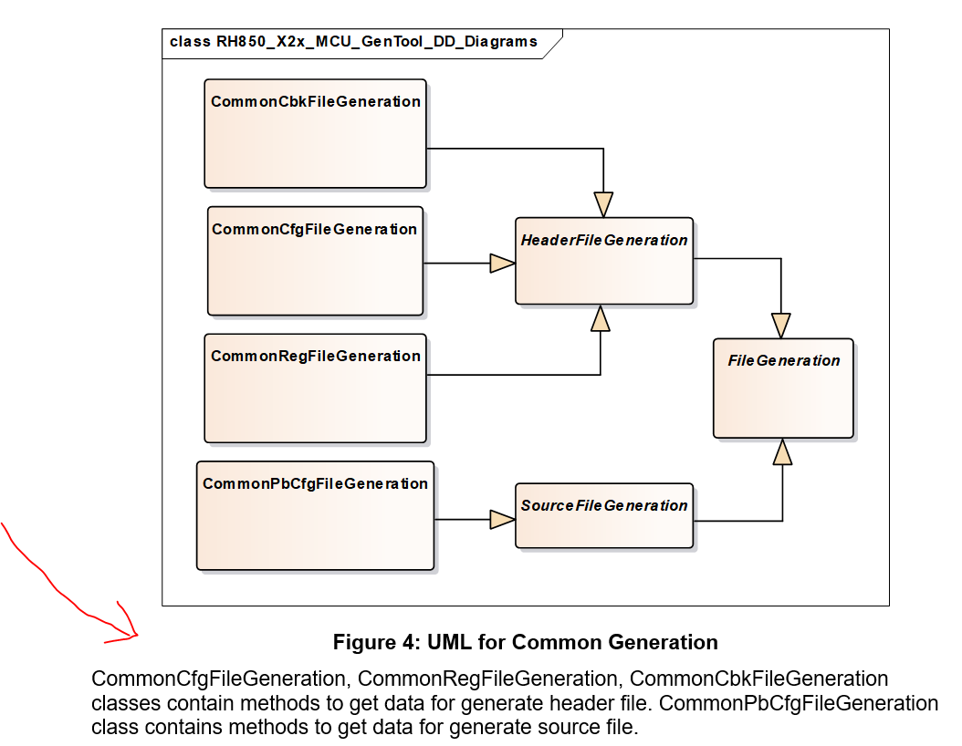
UML
Save RH850_X2x_<MSN>_Gentool_UD_Diagrams then drag blocks of Generation / Intermediate / MapName / Crosscutting / Utils / Validation to an easy-to-edit space and then layout, select and paste into the UD document. Then Ctrl + Z to revert position of all blocks in RH850_X2x_<MSN>_Gentool_UD_Diagrams and save.
Update description of UML and information of each block.

Slide 23
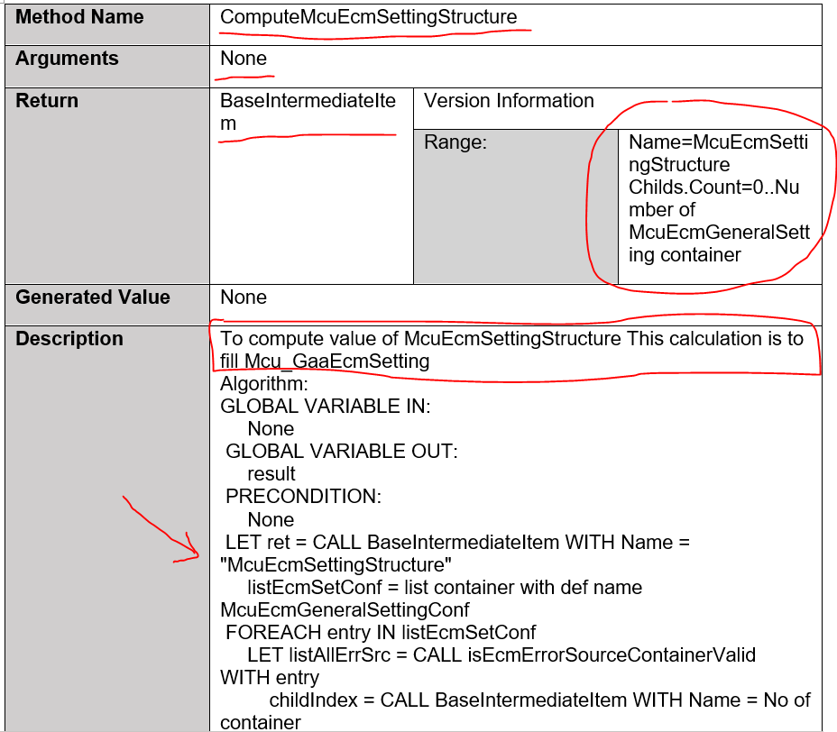
Update method
Verify all information about the method and unify font, size.

Slide 24
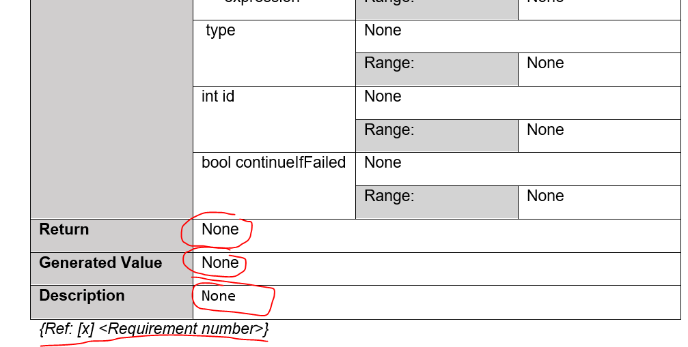
Update method
Pay attention to the Ref section because this will affect mapping between UD and AD.
Check logic code in TCD and Algorithm in UD, if method uses or references to any parameter in CDF design or ERR/WRN/INF in ErrorList design, please list its ID in Ref. (refer to back-up file of the UD for reference)

Slide 25
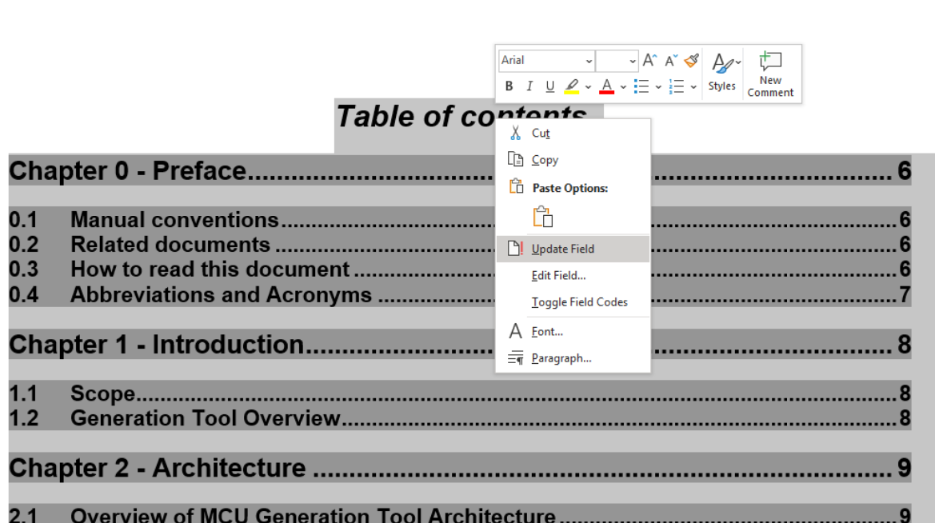
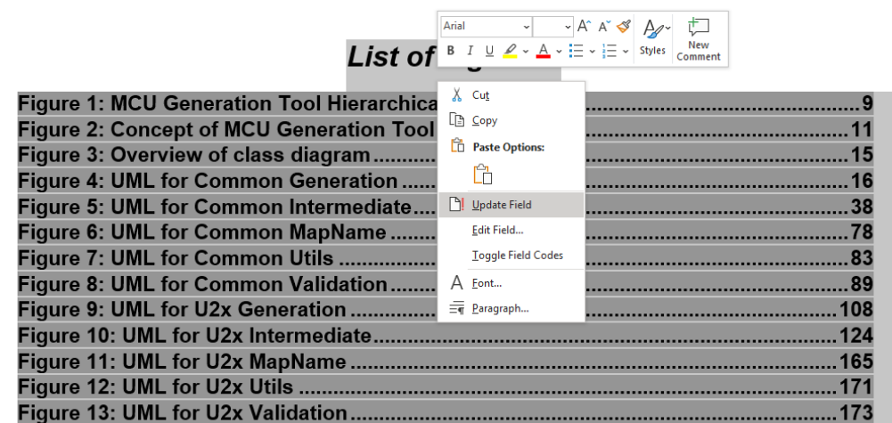
Update method
Remember to update table of contents and check spelling/grammar mistake.

Slide 26
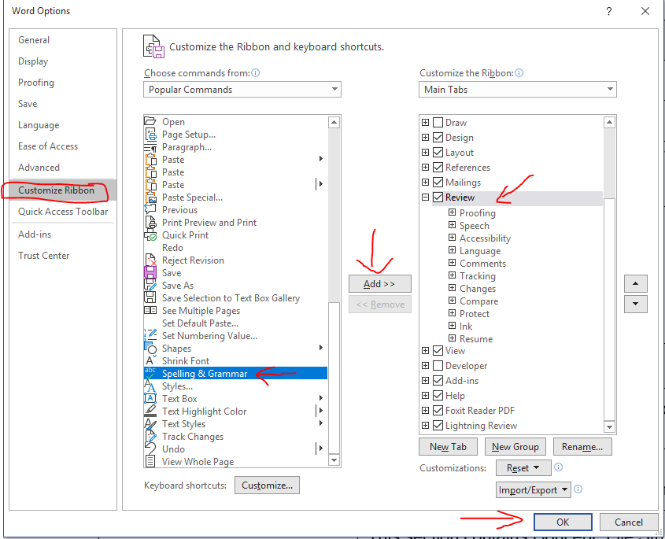
Update method

Slide 27
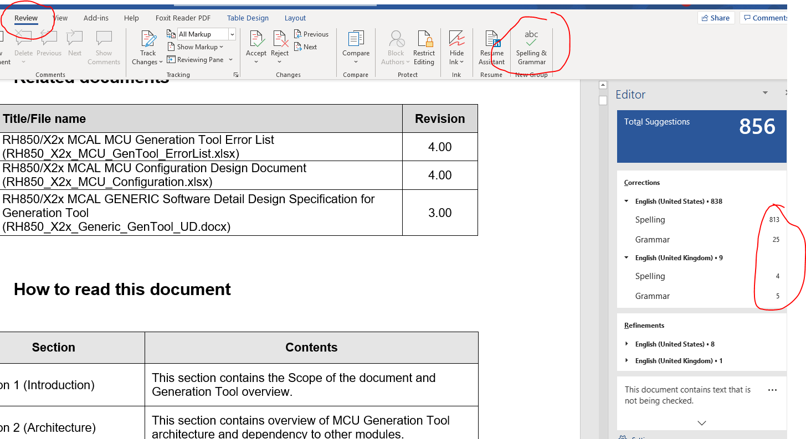
Update method

Slide 28
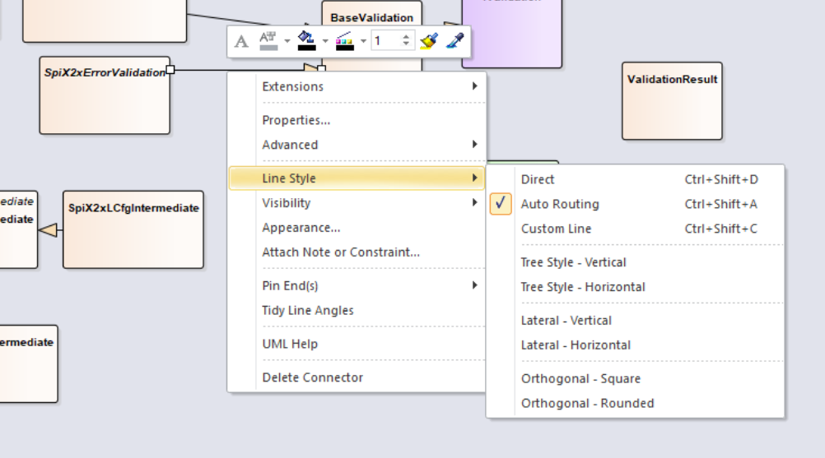
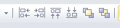
Note
Back-up file “new.docx” to map ID in UT test spec later.
Zoom previous “RH850_X2x_MCU_GenTool_UD.docx” to maximum to have a clear view about Overview of class diagram. Based on this to drag the blocks of Generic
If auto_doc.sh is crashed because of check_mapping_result.py, just ignore it. Because check_mapping_result.py is only affect Ref of methods. But still need to check the tool has generate enough methods yet.
Right click at route and choose Line Style (Auto Routing)
Use icon below to layout blocks easier

Slide 29
Fix REL finding
Check type of method
1. Constructor
2. Internal method: Methods are created to use in other methods. E.g: method_1 is used by methods_a_b_c_d
3. Methods to gen Misra C rule
4. Methods to gen QAC, start stop no init spec,...
5. Method implement for design id of AD but ref is None or N/A, method return null.
6. common method is override by device specific function.
=> Solution:
[1,3,4,5,6] Add new table into Chapter 6 Uncovered List
[2] Get ID by main methods.
Example:
In method CommonCfgFileGeneration table:
{Ref: N/A} change to {ID: SPI_TUD_REF_001}
ID | Methods | Reason for unmapped to design
SPI_TUD_REF_001 | CommonCfgFileGeneration | This is a default constructor.

Slide 30
Thank You!!

